Slide 1
Case Study
Risk Data Scientist

Slide 2
Instruction & Goals
Data description
Dataset presents transactions that occurred, where 148 frauds out of 50,000 transactions
Features V1, V2, … V28 are the principal components
Feature 'Time' contains the seconds elapsed between each transaction and the first transaction
Feature 'Amount' is the transaction Amount, can be used for dependent cost-sensitive learning
Feature 'Class' is the response variable and it takes value 1 in case of fraud and 0 otherwise
Case requirements
The requirement is to build the final model with the highest performance scores - to detect fraudulent transactions
Require to showcase features importance and imbalanced handling
Goal
Build classification model to detect fraudulent transactions
Scope
Feature Importance
Imbalanced class handling
Classification ML model

Slide 3
Analysis Flow Chart
Data Exploratory
Feature Importance & Selection
Imbalanced Handling
Machine Learning Modelling
Evaluation & Model Selection

Slide 4
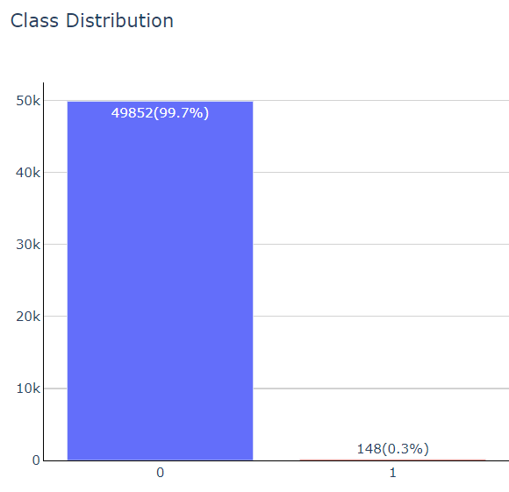

Data Exploratory
Descriptions:
V1, V2, … V28 = principal components
‘Time’ = seconds elapsed between each transaction & first transaction
‘Amount’ = transaction Amount
Scope
Class | Count | Distribution (%)
0 (No Fraud) | 49852 | 99.7
1 (with Fraud) | 148 | 0.3
Imbalanced Class Distribution
Preliminary Assumptions:
With the 2 labels Time, Amount that are not principal component, are they contributing/useful for Fraud detection?
Will Fraud transaction usually happen within a specific timeframe?
Will Fraud transaction have typically unusual amount? Will Fraud amount usually high?

Slide 5
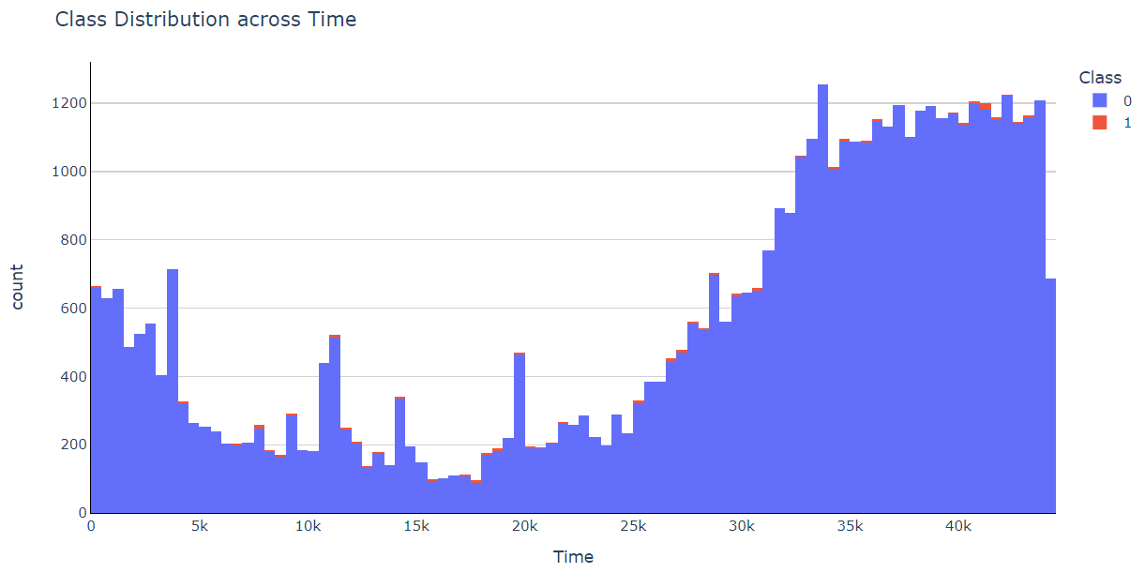
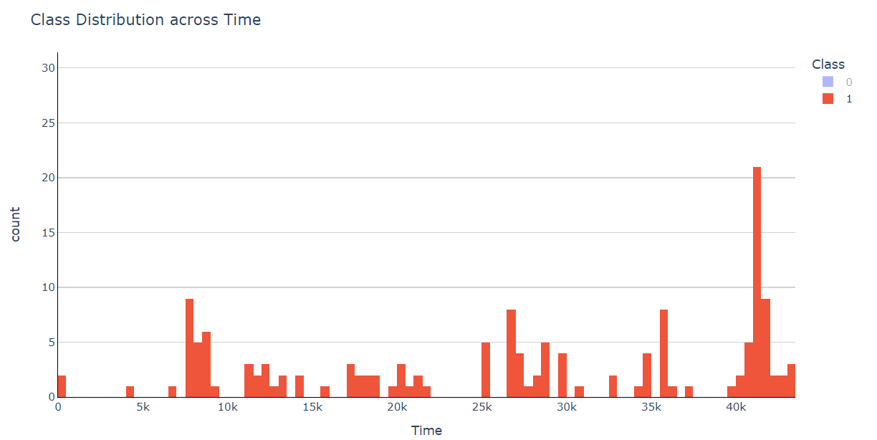
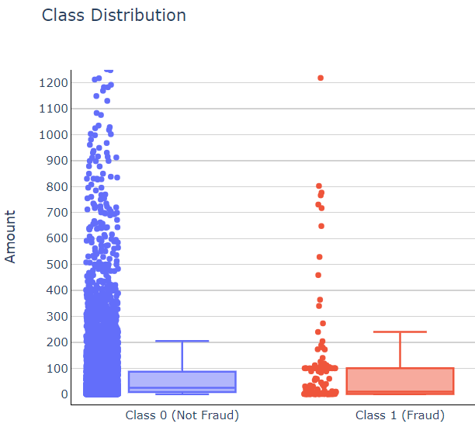
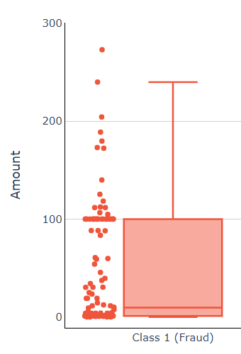
Quick Glance into Features
Will Fraud transaction usually happen within a specific timeframe?
Although there is window of high occurrence of fraud transaction, but more likely due to typical peak hours (usually more transaction), there is no significant seasonal traces of high occurrence in any timeframe.
Will Fraud transaction have typically unusual amount? Will Fraud amount usually high?
As observed:
Fraud amount doesn't usually big as per assumptions made.
Where most of the time happened below 240, and frequent occurrence is near 100.
Although frequent occurrence is near 100, but there are no significant segregation points from the majority no-fraud cases (less correlation from bare-eye observations)

Slide 6
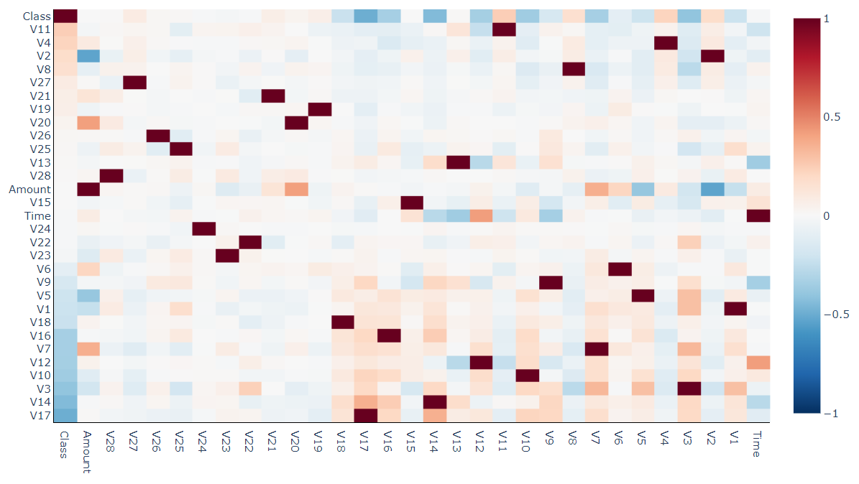
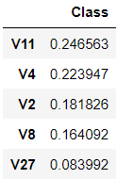
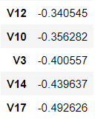
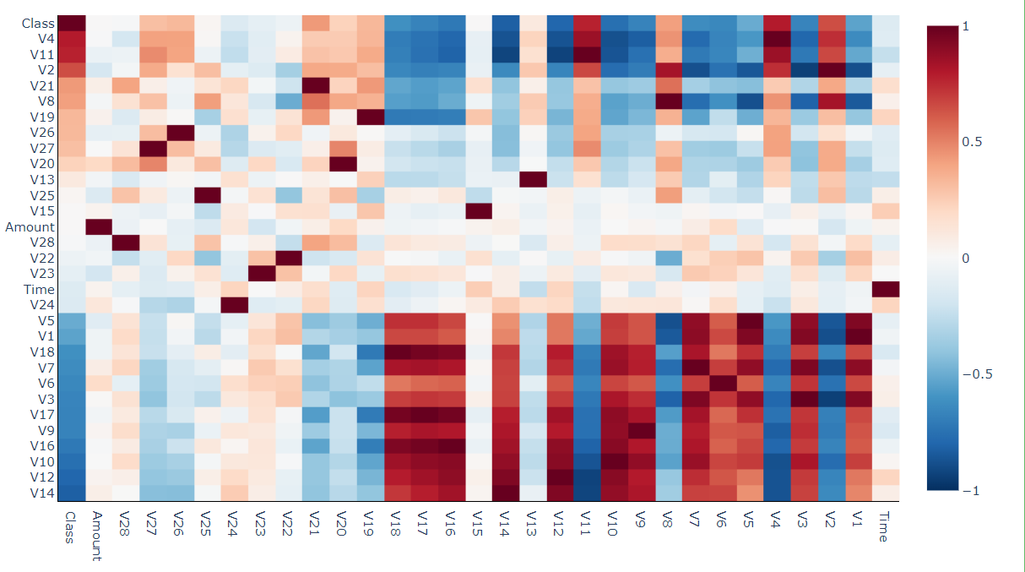
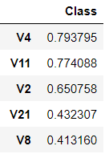
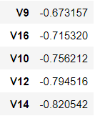
Feature Importance
Full Dataset for Correlation Analysis
Pearson Correlation
Full Dataset
Findings:
Due to dataset is highly imbalanced, Pearson correlation wouldn't perform well
Output of correlation matrices subjected that most features does not show sign of significantly correlated
Compute Pearson Correlation
Under-sample dataset for Correlation Analysis
Pearson Correlation
Full Dataset
Under-sampled but balanced class distribution
Findings:
As observed, Pearson correlation is better measured when there is more balanced class distributions
initial assumptions on important features are:
Compute Pearson Correlation

Slide 7
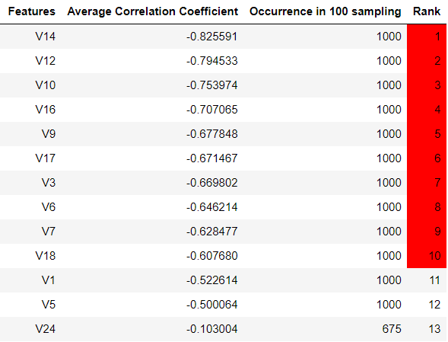
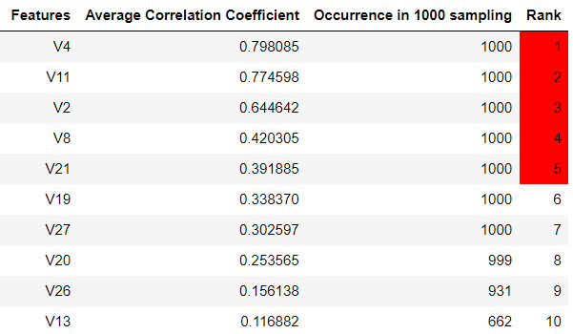
Feature Selection
Full Dataset
Full Dataset
Full Dataset
Full Dataset
Random Under-sampling (1000 loops)
Positive Correlated Features:
Features V4, V11, V2, V8, V21 always occurs in top 5 correlated features
Although their correlation coefficient is not statistically significant, but they are positively correlated
Negative Correlated Features:
Negatively correlated features are observed to be more than positive correlated features
Features V14, V12, V10, V16, V9, V17, V3, V6, V7, V18 always occurs in top 10 correlated features
Although their correlation coefficient is not statistically significant, but they are positively correlated
Pearson Correlation

Slide 8
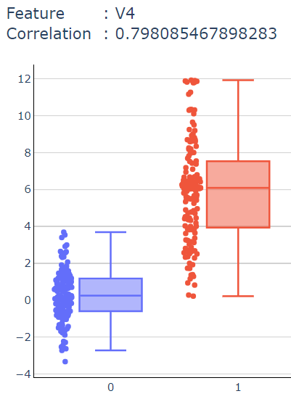
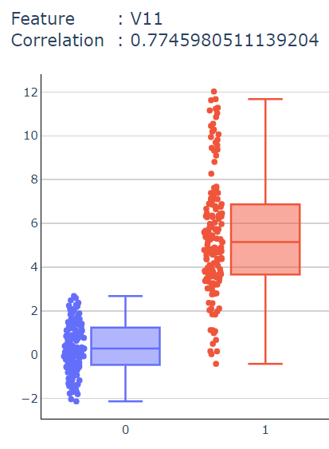
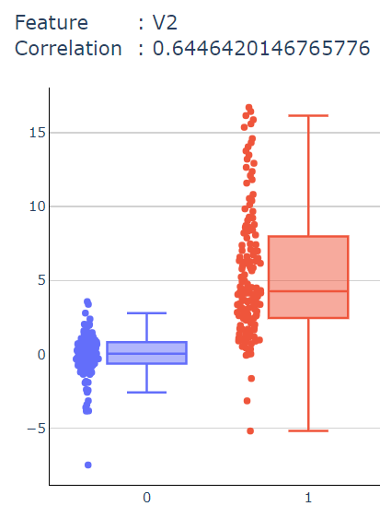
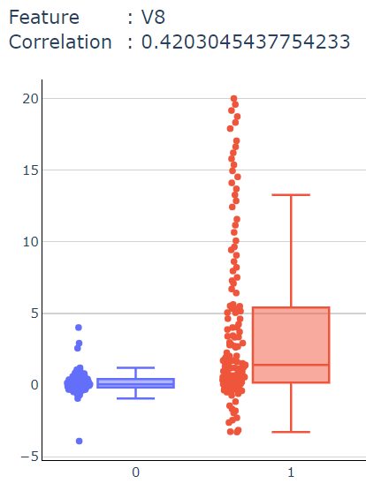
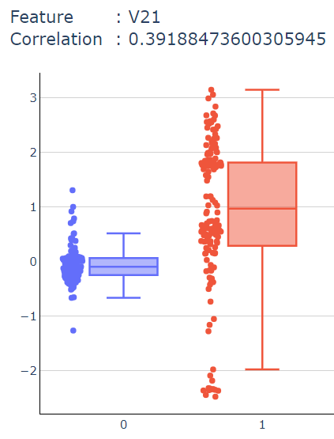
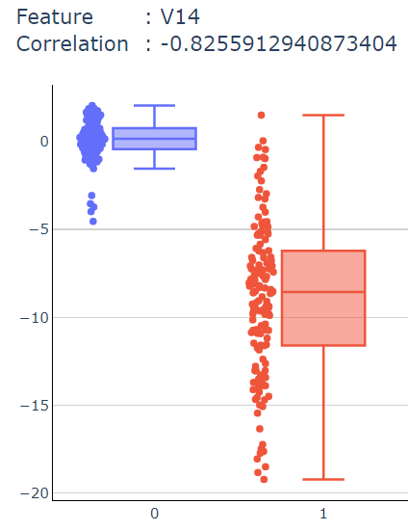
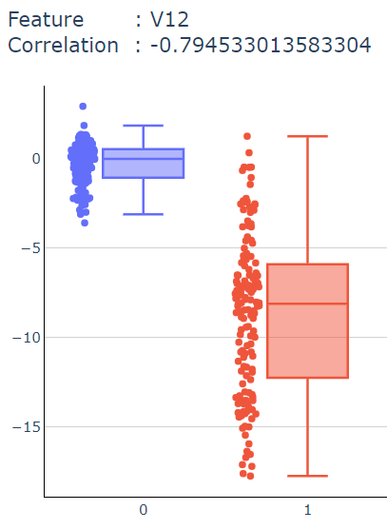
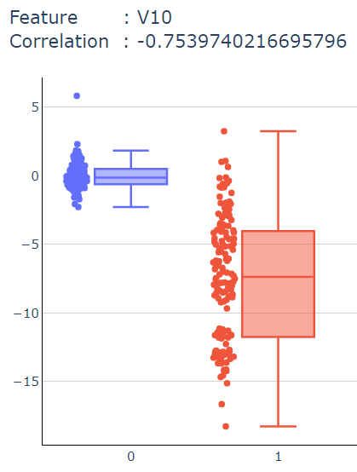
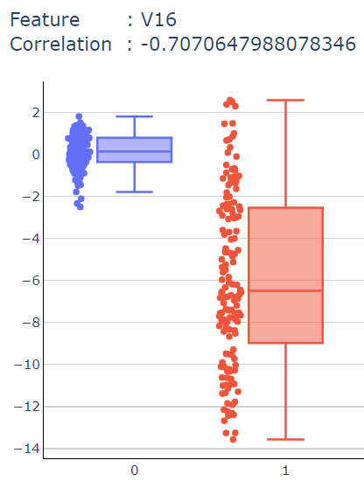
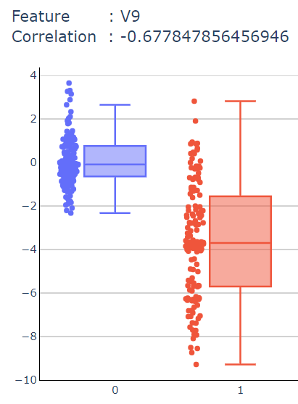
Quick Peek into Selected Features
Features with Positive Correlation (Top 5)
Observations & Validations:
Top 5 positive correlated features shown more significant segregation points (V4,V11,V2 more obvious).
Top 10 negative correlated features shown more significant segregation points (V14, V12, V10, V16 more obvious).
Overall, they would still potentially give good clues for our classifier later for fraud classification
Initial assumptions of Time & Amount features are not among the most correlated features
Selected Important Features for Modelling:
Top 5 positive correlated features +
Top 10 negative correlated features
Features with Negative Correlation (Top 10)

Slide 9

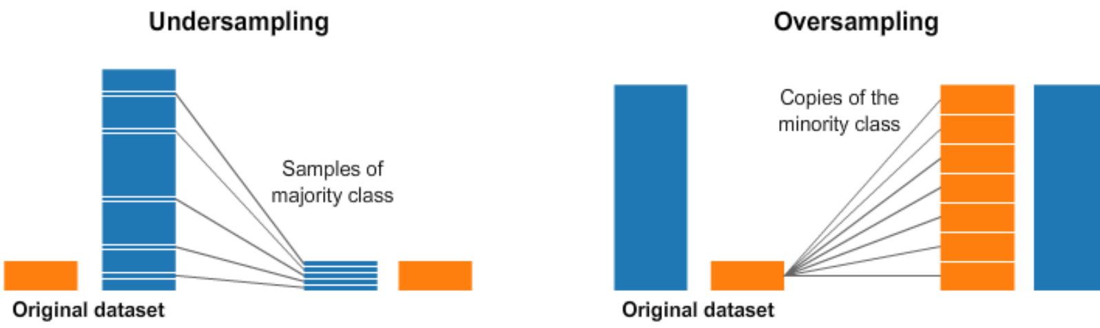

Dataset with selected Features
Dataset split to K-fold to perform cross validation
Dealing with Imbalanced Data
Proposed Under-sampling Approach:
Under-Sampling approach (NearMiss) is applied to randomly eliminating samples from the majority class to balance the class distribution
Proposed Over-sampling Approach:
Over-Sampling approach (SMOTE) is applied to boost minority class to have a more equal balance of the classes.
Machine Learning Modelling

Slide 10
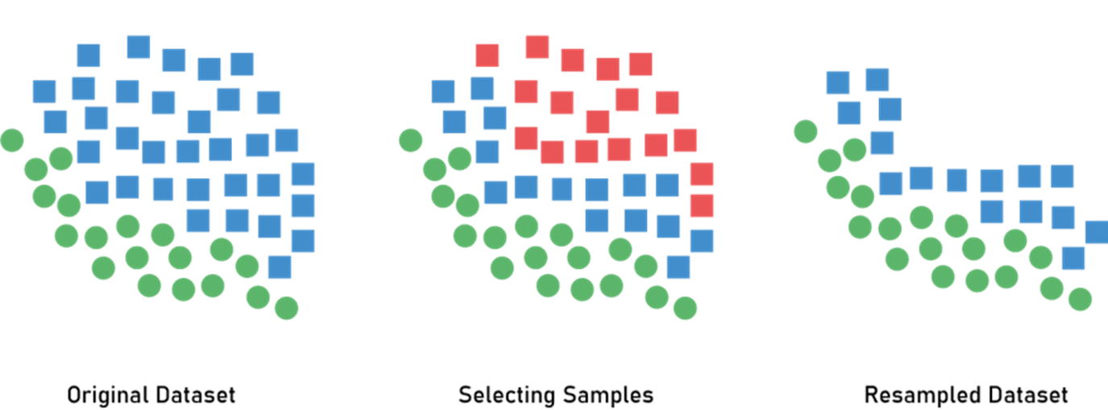
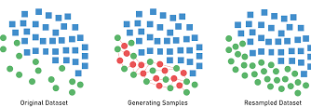
Imbalanced Handling Approach Comparison
Image Source: NearMiss
Image Source: SMOTE
Over-sampling :
SMOTE (Synthetic Minority Over-sampling Technique)
Under-Sampling :
NearMiss
NearMiss Approach (Under-Sampling)
Near-Miss algorithm are used to randomly eliminating samples from the larger class to balance an imbalanced dataset.
If simply randomly sample from majority class, the extracted dataset might lead to information loss, Near-Miss algorithm could help in prevent problem of information loss as it reduced sample size based on near-neighbour methods.
In later approach, Near-miss version 1 is used as our goal is to reduce samples of majority class that are similar.
Near-Miss version definition:
Version 1 : Selects samples of the majority class for which average distances to the k closest instances of the minority class is smallest.
Version 2 : Selects samples of the majority class for which average distances to the k farthest instances of the minority class is smallest.
Version 3 : Combination of Version 1 and Version 2
SMOTE Approach (Over-Sampling)
SMOTE (Synthetic Minority Over-sampling Technique) are used to create synthetic points from the minority class in order to have equally balance between the minority and majority class
SMOTE picks the distance between the closest neighbors of the minority class, in between these distances it creates synthetic points.
Advantage of using SMOTE: More data & information is retained as no rows are removed like under-sampling
Reference: NearMiss
Reference: SMOTE

Slide 11
Machine Learning Modelling (Training Set)
Baseline model
(use full & raw dataset)
Logistic Regression
Model using Selected Features
Support Vector Machine
Apply GridSearchCV
(Optimized Hyperparameter)
Decision Tree
Apply NearMiss Approach
(Under-Sampling)
Apply SMOTE Approach
(Over-Sampling)
Best ML Model Pipeline
 | F1 Score
 | Logistic Regression | SVM | Decision Tree | Comments
Baseline model (use full & raw dataset) | 0.4 | 0.0 | 0.58 | Underfit
Model using Selected Features | 0.4 | 0 | 0.58 | Underfit
Apply NearMiss Approach (Under-Sampling) | 0.8 | 0.67 | 0.05 | Acceptable
Apply SMOTE Approach (Over-Sampling) | 0.3 | 0.79 | 0.14 | Acceptable

Slide 12
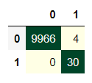
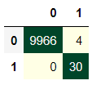
Evaluation & Model Selection
 | Evaluation Metrics | Under-sampling (NearMiss) Logistic Regression Model | Over-sampling (SMOTE) SVM Model
Training Set | Accuracy | 99.87% | 98.47%
 | Precision | 0.82 | 0.80
 | Recall | 0.82 | 0.83
 | F1 Score | 0.80 | 0.79
Testing Set | Accuracy | 99.66% | 99.66%
 | Precision | 0.94 | 0.94
 | Recall | 1.00 | 1.00
 | F1 Score | 0.97 | 0.97
Conclusion:
Model with highest performance scores and more robust in both Training & Testing Set :
Under-sampling (NearMiss v1)
Logistic Regression Model
Hyperparameters = C=0.001
Feature Set of ['V4', 'V11', 'V2', 'V8', 'V21', 'V14', 'V12', 'V10', 'V16', 'V9', 'V17', 'V3', 'V6', 'V7', 'V18']

